Slide 1


Yash Sharma
23030141080
ZOMATO SALES DASHBOARD
"Never have a bad meal, Every meal matters, Shaping the future of food”

Slide 2


Operational Efficiency
Zomato aims to improve its operational efficiency by gaining deeper insights into its sales data.
Problem Statement
Cuatomer Satisfaction
The ultimate goal is to increase customer satisfaction by using data-driven insights to enhance user experiences.
Comprehensive analysis
The project involves a thorough examination of food delivery sales data to develop informative visualizations and reports.

Slide 3
Facts Table
Column | Data Type | Description
Sale_ID | INT | Primary key, unique identifier for each sale.
Restaurant_ID | INT | Foreign key referencing the Restaurant table.
Cuisine_ID | INT | Foreign key referencing the Cuisine table.
City_ID | INT | Foreign key referencing the City table.
Order_ID | INT | Foreign key referencing the Order table.
Monthly_Income_Range_ID | INT | Foreign key referencing the MonthlyIncomeRange table.
Gender | VARCHAR | Gender of the customer (Male, Female).
Sale_Amount | DECIMAL | The amount of the sale.
Order_Date | DATE | Date of the order.

Slide 4
Dimension Tables
Column | Data Type | Description
Restaurant_ID | INT | Primary key, unique identifier for each restaurant.
Restaurant_Name | VARCHAR | Name of the restaurant.
City_ID | INT | Foreign key referencing the City table.
Column | Data Type | Description
Cuisine_ID | INT | Primary key, unique identifier for each cuisine.
Cuisine_Name | VARCHAR | Name of the cuisine (e.g., Indian, Chinese).

Slide 5
Dimension Tables
Column | Data Type | Description
City_ID | INT | Primary key, unique identifier for each city.
City_Name | VARCHAR | Name of the city.
State | VARCHAR | State or region where the city is located.
Country | VARCHAR | Country where the city is located.
Column | Data Type | Description
Order_ID | INT | Primary key, unique identifier for each order.
Order_Type | VARCHAR | Type of order (Veg, Non-Veg).
Quantity | INT | Quantity of items ordered.
Customer_ID | INT | Foreign key referencing the Customer table.

Slide 6
Dimension Tables
Column | Data Type | Description
Monthly_Income_Range_ID | INT | Primary key, unique identifier for each income range.
Income_Range | VARCHAR | Description of income range (e.g., Below ₹10,000, ₹10,001-₹25,000).

Slide 7
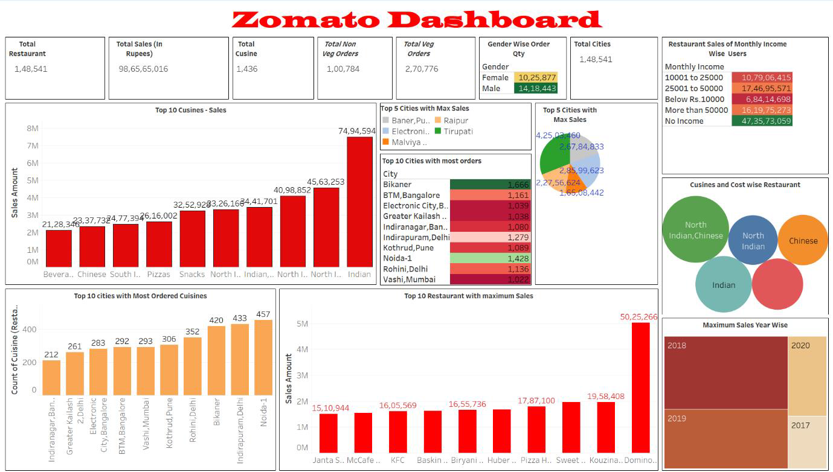

Slide 8
Top-Level KPIs:
1) Total Restaurants: 1,48,541: The total number of restaurants.
2) Total Sales (In Rupees): ₹98,65,65,016: The total sales revenue generated by the restaurants.
3) Total Cuisine: 1,436: The total number of different cuisines offered by the restaurants.
4) Total Non-Veg Orders: 1,00,784: The total number of non-vegetarian orders placed.
5) Total Veg Orders: 2,70,776: The total number of vegetarian orders placed.
6) Total Cities: 1,48,541: The number of cities included in this data, matching the total number of restaurants, likely indicating data is collected from multiple restaurants across these cities.
7) Gender Wise Order Quantity:
a) Female: 10,25,877
b) Male: 14,18,443
c) The data suggests that male customers have placed more orders compared to female customers.

Slide 9
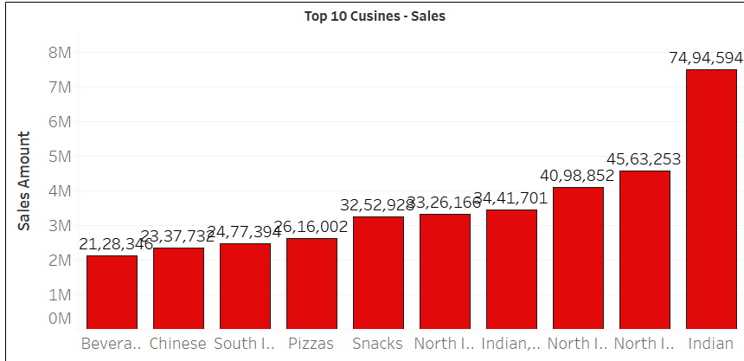
Top 10 Cuisines - Sales (Bar Graph):
The bar graph shows the sales revenue for the top 10 cuisines.
Indian cuisine leads with approximately ₹7.5 million in sales.
Other high-selling cuisines include North Indian, Chinese, and South Indian.
Beverages, snacks, pizzas, and other regional cuisines also contribute significantly.

Slide 10
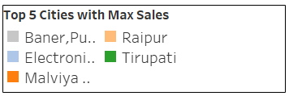
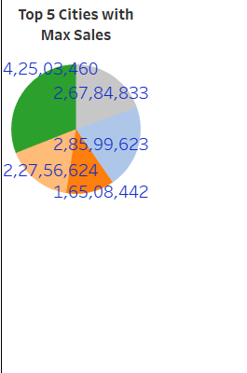
Top 5 Cities with Maximum Sales (Pie Chart):
Baner, Pune tops the list, followed by Raipur, Electronic City, Bangalore, Tirupati, and Malviya Nagar, Delhi.

Slide 11
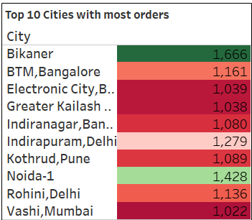
Top 10 Cities with Most Orders (Heat Map):
This heat map highlights the cities with the most orders, with Bikaner leading at 1,666 orders.
Other significant cities include BTM, Bangalore (1,161 orders), Electronic City, Bangalore (1,039 orders), and Greater Kailash, Delhi (1,038 orders).

Slide 12
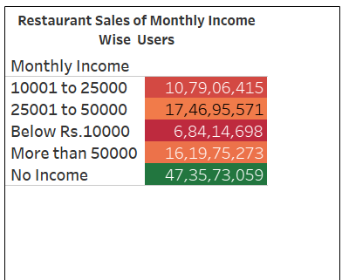
Restaurant Sales by Monthly Income (Table):
This table breaks down restaurant sales by the monthly income range of users.
Users with an income of ₹10,001 to ₹25,000 contribute the most, followed by those earning ₹25,001 to ₹50,000.
Users with "No Income" still contribute a significant amount, possibly indicating students or dependent family members.

Slide 13
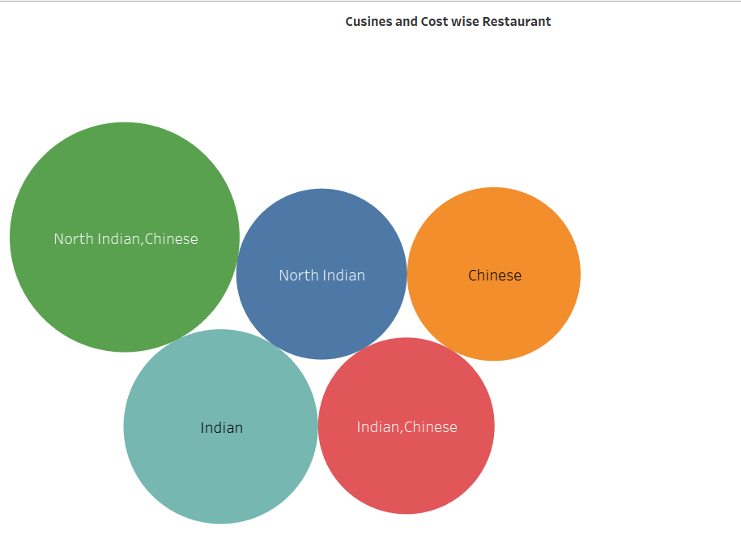
Cuisines and Cost-Wise Restaurant (Bubble Chart):
This bubble chart indicates the correlation between different cuisines and their average cost range.
Larger bubbles, like North Indian and Chinese or Indian, suggest these are popular and widely available cuisines with varied cost brackets.

Slide 14
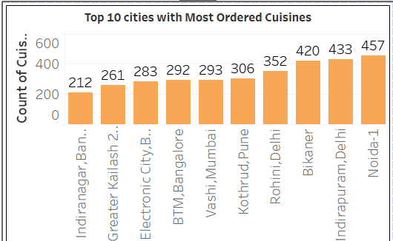
Top 10 Cities with Most Ordered Cuisines (Bar Graph):
The bar graph lists cities with the most ordered cuisines.
Noida-1 leads with 457 restaurants offering the most popular cuisine.
Indirapuram, Delhi, and Bikaner also show high counts, indicating significant culinary diversity.

Slide 15
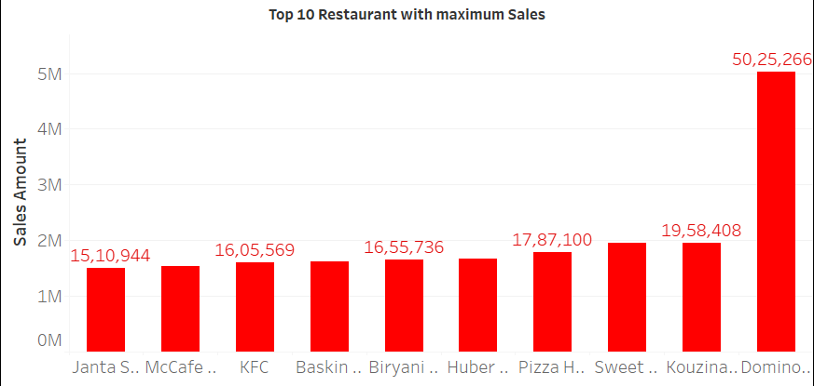
Top 10 Restaurants with Maximum Sales (Bar Graph):
The graph shows the sales figures of the top 10 restaurants.
Domino's has the highest sales, followed by Huber & Holly and Sweet Truth.
Other notable restaurants include McCafe, KFC, and Baskin Robbins.

Slide 16
General Insights:
Indian cuisine is the most popular choice among consumers, with North Indian and Chinese cuisines also enjoying considerable sales.
Certain cities, such as Pune and Raipur, are major contributors to these sales, reflecting a robust culture of food delivery.
A notable portion of revenue is generated by middle-income individuals, although those without a consistent income also make a significant impact.
Leading restaurant chains, including Domino's and McCafe, demonstrate strong sales performance, highlighting their established brand presence and customer loyalty.

Slide 17
Solutions
To problem statement
Targeted Marketing Campaigns
Cuisine Expansion
Leverage customer demographic insights (such as gender, income level, and location) to tailor marketing campaigns. For example, targeting cities with lower order volumes to boost sales.
Use insights from popular cuisines (like Indian, North Indian, and Chinese) to expand market offerings or introduce new cuisine categories that align with customer preferences.
Revenue from Low Income segments
Despite "No Income" customers contributing significantly to sales, potentially indicating students or dependents, Zomato can introduce budget-friendly meal options or student discounts to further tap into this segment.

Slide 18
Thank
you!

